Slide 1
Lecture 6: Electric & Hybrid & Hydrogen vehicle technology

Slide 2
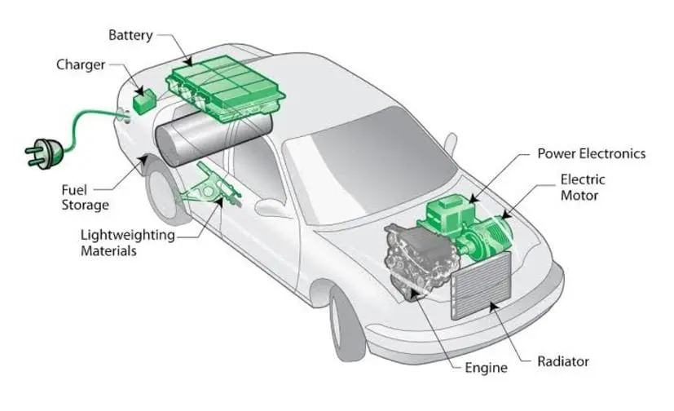
ELECTRIC VEHICLE (EV)
EVs date back to 1834 and the credit goes to a Vermont blacksmith, Thomas Davenport who constructed first non-rechargeable DC motor
based electric car
However, EVs got disappeared in 1920s and ICEV gained the momentum and captured the market
But, EVs as a means of cleaner mobility drawn attention of authorities to curb climate change
To decarbonize the transport sector, electric mobility is a promising option
EVs are those type of vehicles that are completely or partially powered by electricity

Slide 3
ELECTRIC VEHICLE (EV) (2)
EVs are propelled by electric motor which is powered by
rechargeable batteries
EV cars mechanically are less complex when compared to traditional ICE vehicles
EVs have low running costs
Global EVs fleet = 7.4 million (2019)
Leading Countries: China, USA and Norway

Slide 4
ELECTRIC VEHICLE (EV) (3)
Electric Vehicle
(Evs)
Battery Electric
Vechicles (BEVs)
Plug-in Hybrid
Electric Vehicles
(PHEVs)
Hybrid Electric
Vehicles (HECs)
Fuel Cell Electric
Vehicles (FCEVs)
Extended-Range
Electric Vehicle
(ER-EVS)
Hybrid Electric Vehicles (HEVs)

Slide 5
HYBRID VEHICLE (HV)
HV is a combination of two different vehicle
systems incorporated into one vehicle:
IC engine
Electric motor powered by batteries
Based on the method of charging, HVs can be
categorized as:
Hybrid
Plug-in Hybrid
The battery of HV is charged by regenerative
braking and also by IC engine. Electric power
is suitable for small range
Plug-in HV can also be plugged-in for charging
and provide relatively higher range.

Slide 6
HYBRID VEHICLE (H2V)
Vehicle utilizing hydrogen as fuel for motive power
H2V promises a cleaner means of transport
Emits no harmful pollutant but only water vapor
Categorized in Two forms:
Hydrogen IC Engine (HICE)
Fuel cell Vehicle (FCV)

Slide 7
HYBRID VEHICLE (H2V) (2)
HICE is a hybrid technology vehicle wherein hydrogen is pumped into the combustion
chamber along with the gasoline fuel
FCVs are the vehicle which convert chemical energy contain in hydrogen into electrical
energy via fuel cells
Fuel cells can generate electricity continuously for as long as fuel and oxygen are provided

